Slide 1
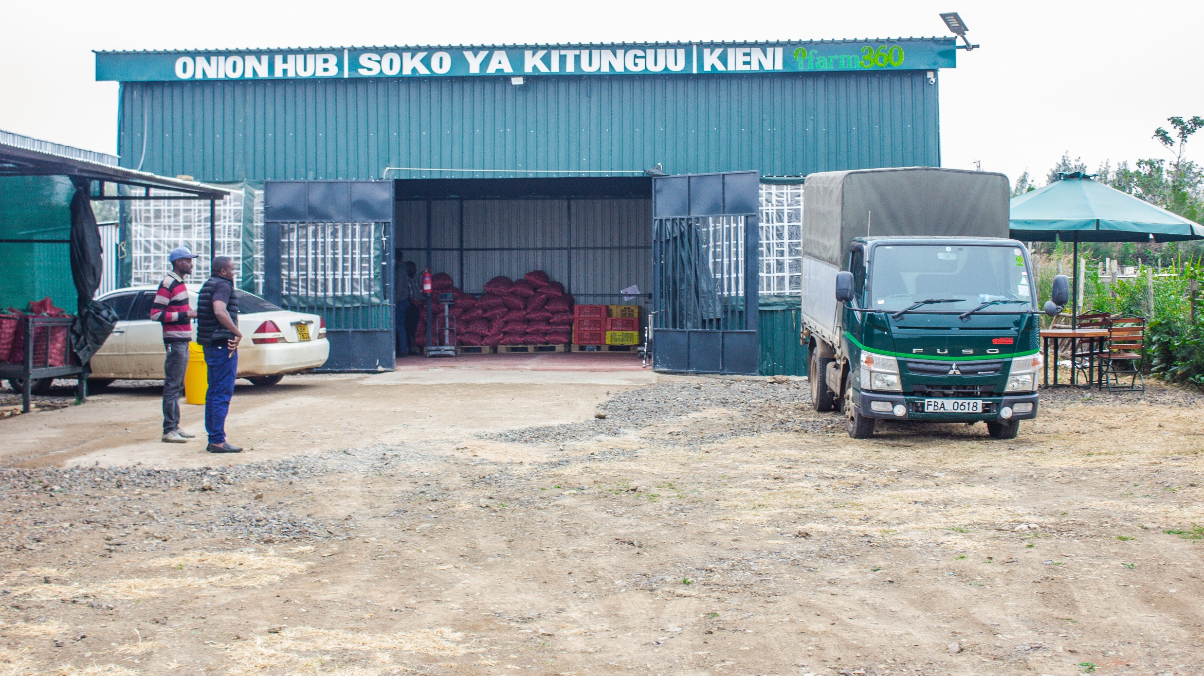
Ifarm360
Empowering farmers to farm as a business to promote food security and fight poverty

Slide 3
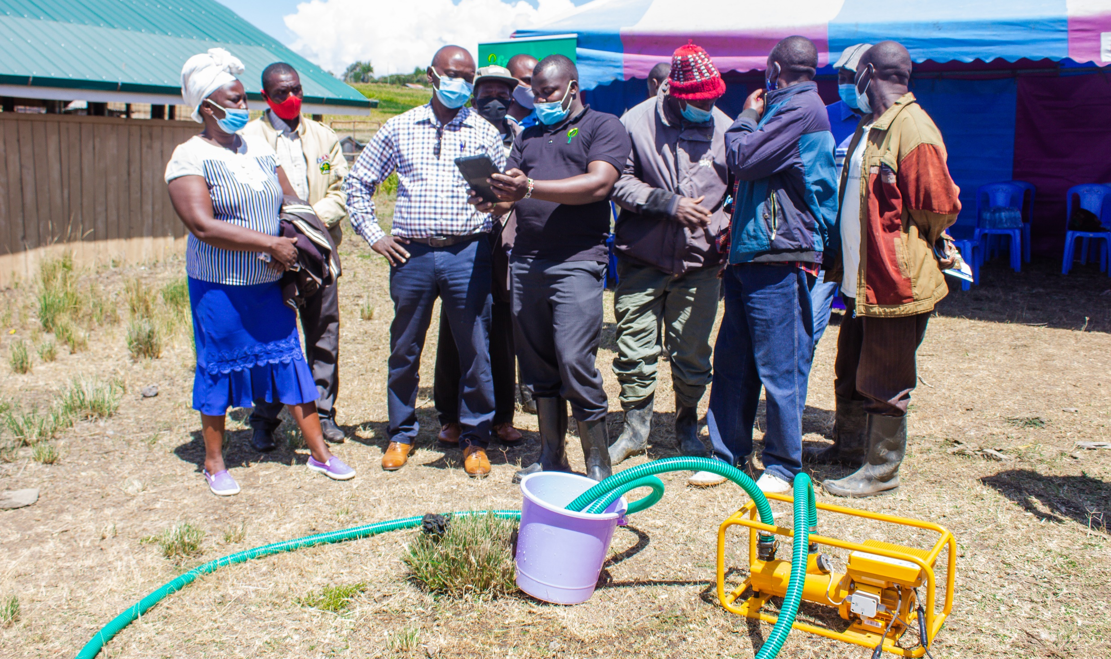

Slide 5
Agriculture is a $ 1 Trillion decade long opportunity for Africa and It’s Youth.

Slide 6
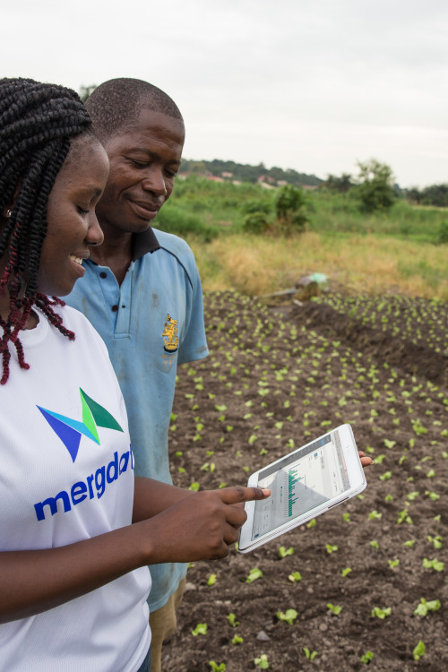
The Youth will transforming Food Systems and win

Slide 7
Areas of youth Engagement
R&D for the agricultural economy
Farmer Financial inclusion
Advisory and Information of Agricultural Productivity
Data Analytics and Agricultural Intelligence
Market linkages
Education and training (Professionals) i.e agronomists, engineers, food scientists.
Food processing, value-addition and logistics

